Slide 1


ADR Ethics
Mediation Center 30-hour Mediation
James J. Street
September 20, 2024

Slide 2
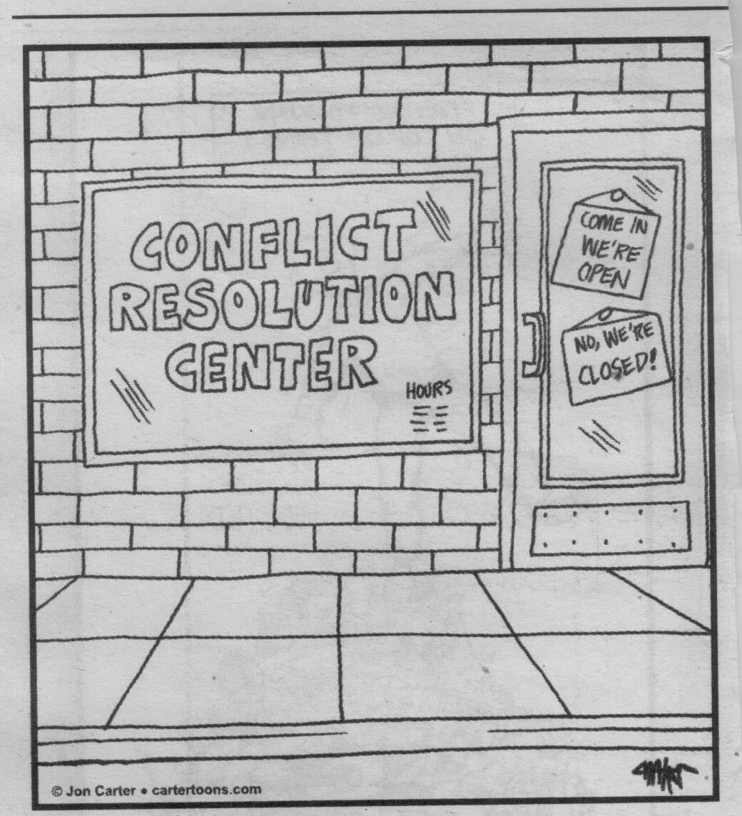

Slide 3



Why Bother?

Slide 4
Snowplowing
No one wants to violate ethical rules
No one wants to be accused of violating ethical rules
Not sure where the line is – make sure don’t approach the line
Causes opportunity cost of otherwise being helpful

Slide 5

__________________________________________________________________________________________
Your Ethical Requirements
_________________________________________________________________________________________
Ethical Complaint Avoidance
______________________________________________________________________________________________ Ethical Requirements

Slide 6
Impartiality
  You are mediating a divorce and the wife alleges that there has been domestic abuse in the relationship. Husband denies that there has been any domestic abuse. You decide to meet with the wife separately to determine what, if any, safety concerns she has about the process. Husband alleges that you are favoring the wife because you believe the wife when she says there has been domestic abuse.

Slide 7

114.13, subd. 1 Impartiality
A neutral shall conduct the dispute resolution process in an impartial manner and shall serve only in those matters in which she or he can remain impartial and evenhanded. If at any time the neutral is unable to conduct the process in an impartial manner, the neutral shall withdraw. .

Slide 8
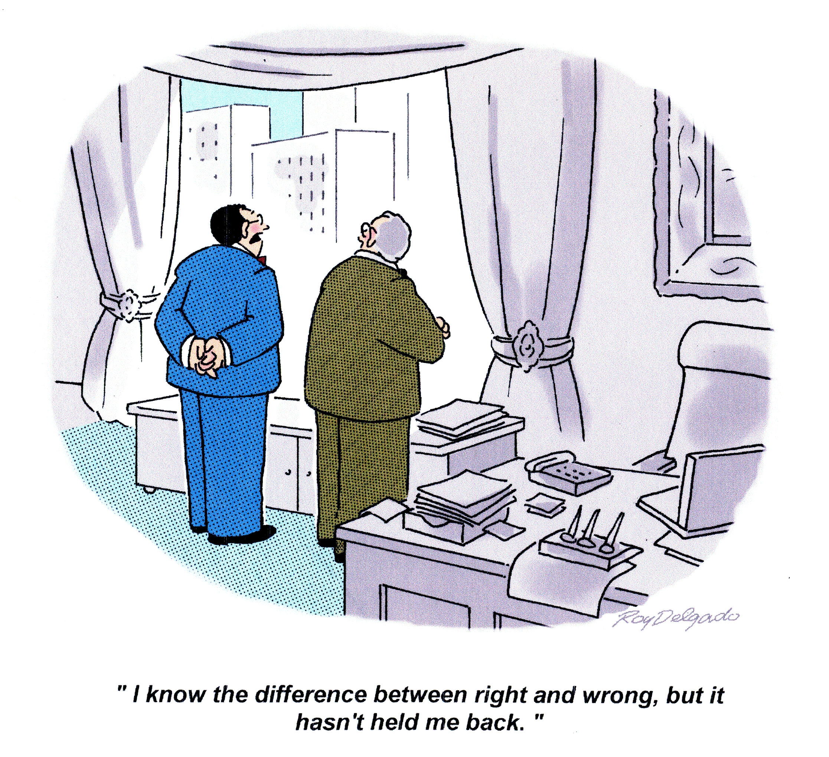

Slide 9

Conflict of Interest
You are mediating a dispute between two neighbors who are represented. You have worked with both attorneys previously in other cases you have mediated. One of the parties to the dispute attends the same place of worship you practice. One of the attorneys went to graduate school with you and you were in the same study group.

Slide 10
114.13, subd. 2 Conflict of Interest
A conflict of interest is a direct or indirect financial or personal interest in the outcome of the proceeding or any existing or past financial, business, professional, family or social relationship which is likely to affect impartiality or which might reasonably create an appearance of partiality or bias. The Neutral must be committed to the parties and the ADR process and not allow pressures from outside the ADR process to influence the Neutral’s conduct or decisions.
Notes:
The Rule defines a conflict of interest for the first time
Must be committed to the process and be free from outside pressures

Slide 11
114.13, subd. 2 Conflict of Interest
Committed to process; free of outside pressures;
Disclose all potential conflicts reasonably known;
After disclosure may serve if waiver but exercise caution if legitimate questions of legitimacy of process;
If your neutrality is impaired must withdraw
Shall not establish a professional relationship with one of the parties in that profession for a reasonable time and without the consent of the parties

Slide 12
Bonus Question – Conflict of Interest
You work in the same office as another mediator. A couple approaches you to mediate a business dispute. You do a conflict check and discover that your office mate mediated one a dispute with one of the party’s in a financial matter four years ago.

Slide 13
Rule 310.03(d)
Availability of Child Custody Investigator. A Neutral serving in a confidential ADR process in a family law matter may not conduct a custody investigation/evaluation in the same matter unless (1) after full disclosure by the Neutral of the nature of the change in roles, the parties agree in writing executed after the termination of the ADR process, that the Neutral shall conduct the investigation/evaluation; (2) the court finds there is no other person reasonably available to conduct the investigation/evaluation and orders the custody investigation/evaluation; and (3) the Neutral informs the parties in writing that disclosures will not be kept confidential.

Slide 14
Competence
The dispute you are asked to mediate with a couple involves what to do with a family business in a divorce where both parties were involved in its operations. You meet with them for three hours and they reach a resolution. Afterwards, one of the parties realizes the resolution resulted in a huge tax consequence which was not addressed in the dispute. One of the parties accuses you of being incompetent to mediate this dispute.

Slide 15
114.13, subd. 3 Competence
No person shall serve as a Neutral unless they possess the qualifications and ability to fulfill the role that the Neutral has been requested or assigned to serve and must decline appointment, request assistance, or withdraw when a dispute is beyond the Neutral's competence. No individual may act as a Neutral for compensation without providing the parties with a written statement of qualifications prior to beginning services. The statement shall describe the Neutral's educational background and relevant training and experience in the field.

Slide 16
Confidentiality
You are participating in a program connected with the Court which refers fee generating cases to you and other mediators in the community as they come to the Court. One Judge refers a lot of cases to this program. After one referral on a contentious case, the Judge runs into you and asks about the case. The Judge is genuinely concerned about how to manage this difficult case but is having trouble determining which party is causing the dispute. The Judge wants your insights and asks your input. What do you do?

Slide 17

Rule 114.13, subd.7 (b)
If any court order requires the Neutral to do something that would violate these rules, the Code of Ethics for Court-Annexed ADR Neutrals, or any applicable court rules or statutes, the Neutral must decline appointment or defer appointment until the parties obtain amendment of the appointment order or obtain a subsequent order.
Notes:
Put this here, because this is context in which we saw complaints. Could apply to all rules

Slide 18
Bonus Question
Two neighbors have a dispute with a third neighbor, but the roots of the disputes are different. In Court, both cases appear to be related and the third neighbor wants to coordinate the relief granted to minimize the chance of conflicting orders. The judicial officer refers both neighbors and and the third neighbor to mediate with you so that the resolutions can mesh without conflict.

Slide 19

114.13, subd. 4 Confidentiality
The Neutral shall discuss issues of confidentiality with the parties before beginning an ADR process, including limitations on the scope of confidentiality and the extent of confidentiality provided in any private sessions that a Neutral holds with a party. The Neutral shall maintain confidentiality as required by Rules 114.08, 114.10, and 114.11 of the General Rules of Practice, and any additional agreements made with or between the parties.
Notes:
Cover 114.08 and 114.10 (114.11 is fees – cover that later)

Slide 20
Records
114.08 (a) Records of Neutral. Notes, records, impressions, opinions and recollections of the Neutral are confidential, and the Neutral shall not disclose them to the parties, the public, or any third person, unless (1) all parties and the Neutral agree to such disclosure, or (2) disclosure is required by law or other applicable professional codes or permitted by these rules. No record or recording of an ADR session may be made or disclosed without the agreement of all parties and the Neutral. If an ADR session is conducted in a court facility where proceedings are automatically recorded, the recording made shall not be used for any purpose in the case without the agreement of all parties and the Neutral.
(b) Disclosure to the Court. The Neutral may only disclose to the court information permitted to be disclosed under Rules 114.10-11

Slide 21
Confidentiality v. Admissibility
114.07(a) Evidence. Without the consent of all parties and an order of the court, except as provided in paragraph (c), no evidence from an ADR process or any fact concerning the ADR process may be admitted in any later proceeding involving any of the issues or parties.
(b) Inadmissability. Subject to Minnesota Statutes, section 595.02, and except as provided in paragraphs (a) and (d), no statements made nor documents produced in non-binding ADR processes that are not otherwise discoverable shall be subject to discovery or other disclosure. Such evidence is inadmissible for any purpose at a later trial, including for impeachment.
Notes:
695.02 (m) A person cannot be examined as to any communication or document, including work notes, made or used in the course of or because of mediation pursuant to an agreement to mediate or a collaborative law process pursuant to an agreement to participate in collaborative law. This does not apply to the parties in the dispute in an application to a court by a party to have a mediated settlement agreement or a stipulated agreement resulting from the collaborative law process set aside or reformed. A communication or document otherwise not privileged does not become privileged because of this paragraph. This paragraph is not intended to limit the privilege accorded to communication during mediation or collaborative law by the common law.
(c) Adjudicative Evidence. Evidence in consensual special magistrate proceedings, binding arbitration, or in non-binding arbitration after the period for a demand for trial expires, may be used in later proceedings for any purpose for which it is admissible under the rules of evidence.
(d) Sworn Testimony. Sworn testimony in a summary jury trial may be used in later proceedings for any purpose for which it is admissible under the rules of evidence.

Slide 22
114.10 (c) Communications to the Court DURING
(1) Without comment or recommendations, whether the case has undergone an ADR process and whether it has or has not been resolved;
(2) Whether a party or an attorney has failed to comply with the order to attend the process or pay the court-ordered fees;
(3) Any request by the parties for additional time to complete the ADR process;
(4) With the written consent of the parties, any procedural action by the court that would facilitate the ADR process;
(5) The Neutral's assessment that the case is inappropriate for that ADR process; and
(6) A Neutral may, with the consent of the parties or by court order, disclose to the court information obtained during the ADR process.

Slide 23
114.10(d) Communications to the Court AFTER
(1) That the case has been settled and may also include a copy of the written agreement;
(2) Without further comment, that the case has not been settled and, with the written consent of the parties or their counsel, that resolution of pending motions or outstanding legal issues, discovery process, or other action by any party which, if resolved or completed, would facilitate resolution of the dispute;
(3) That some or all of the fees have not been paid; or
(4) Notice of the court of parenting time adjustments required by Rule 310.03(c)(3).
Notes:
(c)Parenting Time Expediting and Parenting Consulting.
(1) Parenting Time Expediting. Parenting Time Expediting is a process in which a Neutral is appointed by the court pursuant to Minnesota Statutes, section 518.1751, to serve as a Parenting Time Expeditor (PTE). A PTE is limited to addressing parenting time disputes not addressed in court orders, interpreting court orders, and determining if violations of court orders occurred. The process is a hybrid of mediation/arbitration and begins with neutral facilitation of parenting time disputes. If parties are unable to agree, the PTE will make a decision, which is binding unless modified or vacated by the court.
(2) Parenting Consulting. Parenting Consulting is a process defined by the agreement of the parties in which the Parenting Consultant (PC) incorporates neutral facilitation, coaching, and decision making. Terms of the process are defined by the agreement of the parties and incorporated into a court order.
(3) Notice to Court of Parenting Time Adjustments. If adjustments are made to the parenting time previously ordered or agreed upon, the Neutral, or if the Neutral does not do so, counsel for the parties if either party is represented, or in the case both parties who are unrepresented, one of the self-represented parties as designated by the Neutral, shall file a report with the court, limited to stating the specific adjustments to the parenting time terms.
Rule 114.11Fees
(a) Setting of Fee. The Neutral shall be paid according to the terms of the agreement with the parties, their attorney, or as ordered by the court. All fees of Neutral(s) for ADR services shall be fair and reasonable.
(b) Remedies for Non-Payment. If parties or attorneys fail to pay the Neutral, the court, with notice to the parties and counsel and upon filing of an affidavit from the Neutral or a party, may issue an order granting such relief as the court deems just and proper. The Neutral, in seeking relief under this rule, shall maintain confidentiality as required by these rules. The Neutral has the right to suspend services if not paid in accordance with the court order or agreement with the parties and/or their attorneys.

Slide 24

Quality of Process
Two parties approach you in June 2022 to mediate a dispute between a contractor and school about resurfacing the school’s parking lot before the school year. You have a long-awaited summer vacation for the month of July. You try to schedule them in June, but because of their schedules they cannot mediate with you until August 14. What do you do?

Slide 25
114.13, subd. 5 Quality of Process
A Neutral shall work to ensure a quality process. A quality process requires a commitment by the Neutral to diligence and procedural fairness. A Neutral shall ensure that the reasonable expectations of the parties concerning the timing of the ADR process are satisfied and shall exert every reasonable effort to expedite the process, including prompt issuance of written reports, awards, or agreements. A Neutral shall withdraw from an ADR process or postpone a session if the process is being used to further illegal conduct, or if a party is unable to participate due to drug or alcohol abuse, or other physical or mental incapacity. A Neutral shall not knowingly make false statements of fact or law.
Notes:
Rule 1.14Client With Diminished Capacity
(a)
When a client's capacity to make adequately considered decisions in connection with a representation is diminished, whether because of minority, mental impairment, or some other reason, the lawyer shall, as far as reasonably possible, maintain a normal client-lawyer relationship with the client.
(b)
When the lawyer reasonably believes that the client has diminished capacity, is at risk of substantial physical, financial, or other harm unless action is taken and cannot adequately act in the client's own interest, the lawyer may take reasonably protective action, including consulting individuals or entities that have the ability to take action to protect the client and, in appropriate cases, seeking the appointment of a guardian ad litem, conservator, or guardian.
(c)
Information relating to the representation of a client with diminished capacity is protected by Rule 1.6. When taking protective action pursuant to paragraph (b), the lawyer is impliedly authorized under Rule 1.6(v)(3) to reveal information about the client, but only to the extent reasonably necessary to protect the client's interests.
(Amended effective October 1, 2005.)
Comment
[1] The normal client-lawyer relationship is based on the assumption that the client, when properly advised and assisted, is capable of making decisions about important matters. When the client is a minor or suffers from a diminished mental capacity, however, maintaining the ordinary client-lawyer relationship may not be possible in all respects. In particular, a severely incapacitated person may have no power to make legally binding decisions. Nevertheless, a client with diminished capacity often has the ability to understand, deliberate upon, and reach conclusions about matters affecting the client's own well-being. For example, children as young as five or six years of age, and certainly those of ten or twelve, are regarded as having opinions that are entitled to weight in legal proceedings concerning their custody. So also, it is recognized that some persons of advanced age can be quite capable of handling routine financial matters while needing special legal protection concerning major transactions.
[2] The fact that a client suffers an impairment does not diminish the lawyer's obligation to treat the client with attention and respect. Even if the person has a legal representative, the lawyer should as far as possible accord the represented person the status of client, particularly in maintaining communication.
[3] The client may wish to have family members or other persons participate in discussions with the lawyer. When necessary to assist in the representation, the presence of such persons generally does not affect the applicability of the attorney-client evidentiary privilege. Nevertheless, the lawyer must keep the client's interests foremost and, except for protective action authorized under paragraph (b), must look to the client, and not family members, to make decisions on the client's behalf.
[4] If a legal representative has already been appointed for the client, the lawyer should ordinarily look to the representative for decisions on behalf of the client. In matters involving a minor, whether the lawyer should look to the parents as natural guardians may depend on the type of proceeding or matter in which the lawyer is representing the minor. If the lawyer represents the guardian as distinct from the ward, and is aware that the guardian is acting adversely to the ward's interest, the lawyer may have an obligation to prevent or rectify the guardian's misconduct. See Rule 1.2(d).
Taking Protective Action
[5] If a lawyer reasonably believes that a client is at risk of substantial physical, financial or other harm unless action is taken, and that a normal client-lawyer relationship cannot be maintained as provided in paragraph (a) because the client lacks sufficient capacity to communicate or to make adequately considered decisions in connection with the representation, then paragraph (b) permits the lawyer to take protective measures deemed necessary. Such measures could include: consulting with family members, using a reconsideration period to permit clarification or improvement of circumstances, using voluntary surrogate decisionmaking tools, such as durable powers of attorney or consulting with support groups, professional services, adult-protective agencies, or other individuals or entities that have the availability to protect the client. In taking any protective action, the lawyer should be guided by such factors as the wishes and values of the client to the extent known, the client's best interests and the goals of intruding into the client's decisionmaking autonomy to the least extent feasible, maximizing client capacities, and respecting the client's family and social connections.
[6] In determining the extent of the client's diminished capacity, the lawyer should consider and balance such factors as: the client's ability to articulate reasoning leading to a decision, variability of state of mind and ability to appreciate consequences of a decision, the substantive fairness of a decision, and the consistency of a decision with the known long-term commitments and values of the client. In appropriate circumstances, the lawyer may seek guidance from an appropriate diagnostician.
[7] If a legal representative has not been appointed, the lawyer should consider whether appointment of a guardian ad litem, conservator, or guardian is necessary to protect the client's interests. Thus, if a client with diminished capacity has substantial property that should be sold for the client's benefit, effective completion of the transaction may require appointment of a legal representative. In addition, rules of procedure in litigation sometimes provide that minors or persons with diminished capacity must be represented by a guardian or next friend if they do not have a general guardian. In many circumstances, however, appointment of a legal representative may be more expensive or traumatic for the client than circumstances in fact require. Evaluation of such circumstances is a matter entrusted to the professional judgment of the lawyer. In considering alternatives, however, the lawyer should be aware of any law that requires the lawyer to advocate the least restrictive action on behalf of the client.
Disclosure of the Client's Condition
[8] Disclosure of the client's diminished capacity could adversely affect the client's interests. For example, raising the question could, in some circumstances, lead to proceedings for involuntary commitment. Information relating to the representation is protected by Rule 1.6. Therefore, unless authorized to do so, the lawyer may not disclose such information. When taking protective action pursuant to paragraph (b), the lawyer is impliedly authorized to make the necessary disclosures, even when the client directs the lawyer to the contrary. Nevertheless, given the risks of disclosure, paragraph (c) limits what the lawyer may disclose in consulting other individuals or entities or seeking the appointment of a legal representative. At the very least, the lawyer should determine whether it is likely that the person or entity consulted will act adversely to the client's interests before discussing matters related to the client. The lawyer's position in such cases is an unavoidably difficult one.
Emergency Legal Assistance
[9] In an emergency where the health, safety, or financial interest of a person with seriously diminished capacity is threatened with imminent and irreparable harm, a lawyer may take legal action on behalf of such a person even though the person is unable to establish a client-lawyer relationship or to make or express considered judgments about the matter, when the person or another acting in good faith on that person's behalf has consulted the lawyer. Even in such an emergency, however, the lawyer should not act unless the lawyer reasonably believes that the person has no other lawyer, agent, or other representative available. The lawyer should take legal action on behalf of the person only to the extent reasonably necessary to maintain the status quo or otherwise avoid imminent and irreparable harm. A lawyer who undertakes to represent a person in such an exigent situation has the same duties under these rules as the lawyer would with respect to a client.
[10] A lawyer who acts on behalf of a person with seriously diminished capacity in an emergency should keep the confidences of the person as if dealing with a client, disclosing them only to the extent necessary to accomplish the intended protective action. The lawyer should disclose to any tribunal involved and to any other counsel involved the nature of his or her relationship with the person. The lawyer should take steps to regularize the relationship or implement other protective solutions as soon as possible. Normally, a lawyer would not seek compensation for such emergency actions taken.

Slide 26

Advertising and Solicitation
You are a mediator, ENE provider, attorney, custody evaluator and Parenting Time Expediter. You advertise yourself as “The Family Justice and ADR Center – a one stop shop for contested family law matters”. You have this marketing approach so that this name is on your website, office signage, letterhead and on top of your retainer agreements.

Slide 27
114.13, subd. 6 Advertising and Solicitation
A Neutral shall be truthful in advertising and solicitation for alternative dispute resolution. A neutral shall make only accurate and truthful statements about any alternative dispute resolution process, its costs and benefits, the Neutral's role and her or his skills or qualifications. A Neutral shall refrain from promising specific results.
In an advertisement or other communication to the public, a Neutral who is on the Roster may use the phrase ”Qualified Neutral under Rule 114 of the Minnesota General Rules of Practice." It is not appropriate to identify oneself as a "certified" neutral.

Slide 28
Fees
Two parties retain you to mediate a lawsuit involving a party wrongfully cutting down a neighbor’s tree. Their agreement is that they will share your fees equally. One party is unable to pay the mediation fee. The other party agrees to front the costs to make sure the mediation can occur.
Can you do this?
The paying party wants you to report this to the judicial officer so that party can be reimbursed. What do you do?

Slide 29

114.13, subd. 7 (a) Fees
A Neutral shall fully disclose and explain the basis of compensation, fees and charges to the parties with sufficient information about fees at the outset to determine if they wish to retain the services of a Neutral.
A Neutral shall not enter into a fee agreement that is contingent upon the outcome of the alternative dispute resolution process.
The fee agreement shall be included in the written agreement and shall be consistent with a court order appointing the Neutral.
A Neutral shall establish a protocol for regularly advising parties on the status of their account and requesting payment of fees.
Notes:
Big changes

Slide 30
114.13, subd. 7 (a) Fees
If one party does not pay the fee, and another party declines to cover the fee, the Neutral may withdraw, proceed, or suspend services for both parties until payment is made.
If proceeding with services, the Neutral shall not refuse participation by any party based on payment status.
A Neutral who withdraws from a case shall return any unearned fee to the parties.
A Neutral shall not give or receive any commission, rebate, or similar remuneration for referring a person for alternative dispute resolution services.

Slide 31
Fees – Bonus Question
You receive a court order which appoints you as the party’s mediator and gives a 60-day deadline for the mediation to occur. Your practice is to receive payment of your retainer prior to mediating and at the time of signing the retainer agreement. One party does not pay.
What do you do?
Notes:
114.10(C) (2)

Slide 32
Rule 114.11 Fees (Communication)
(a) Setting of Fee. The Neutral shall be paid according to the terms of the agreement with the parties, their attorney, or as ordered by the court. All fees of Neutral(s) for ADR services shall be fair and reasonable.
(b) Remedies for Non-Payment. If parties or attorneys fail to pay the Neutral, the court, with notice to the parties and counsel and upon filing of an affidavit from the Neutral or a party, may issue an order granting such relief as the court deems just and proper. The Neutral, in seeking relief under this rule, shall maintain confidentiality as required by these rules. The Neutral has the right to suspend services if not paid in accordance with the court order or agreement with the parties and/or their attorneys.

Slide 33
114.13, subd 7 (b) Fees
Requirement of Written Agreement for ADR Services. In any civil or family court matter in which ADR is used, the Neutral shall enter into a signed written agreement for services with the parties either before or promptly after the commencement of the ADR process. The written agreement shall be consistent with any court order appointing the Neutral. If any court order requires the Neutral to do something that would violate these rules, the Code of Ethics for Court-Annexed ADR Neutrals, or any applicable court rules or statutes, the Neutral must decline appointment or defer appointment until the parties obtain amendment of the appointment order or obtain a subsequent order.

Slide 34
114.13, subd. 7 (b) Written Agreement requires the following
(1) A description of the role of the Neutral.
(2) If the Neutral's role includes decision making, whether the Neutral's decision is binding or non-binding.
(3) An explanation of confidentiality and admissibility of evidence.
(4) If the Neutral is to be paid, the amount of compensation, how the compensation will be paid, and include a notice that the Neutral could seek remedies from the court for non-payment pursuant to Rule 114.11(b) of the General Rules of Practice for the District Courts.

Slide 35

114.13, subd. 7(b)(5) Adjudicative Processes
If adjudicative, the rules of the process.
That the Neutral must follow the Code of Ethics for Court-Annexed ADR Neutrals and is subject to the jurisdiction of the ADR Ethics Board.

Slide 36
114.13, subd. 7(b)(7) Facilitative and Evaluative Processes require:
(A) the Neutral has no duty to protect the interests of the parties or provide them with information about their legal rights;
(B) no agreement reached in this process is binding unless it is put in writing, states that it is binding, and is signed by the parties (and their legal counsel, if they are represented) or put on the record and acknowledged under oath by the parties;
(C) signing a settlement agreement may adversely affect the parties' legal rights;
(D) the parties should consult an attorney before signing a settlement agreement if they are uncertain of their rights; and
(E) in a family court matter, the agreement is subject to the approval of the court.
Notes:
But see, Rhodes et al. v. Stockwell Homes L.L.C, 4 N.W.3d 370 (Minn. Ct. App. 2024)

Slide 37

114.13, subd. 3 When charging for services
No individual may act as a Neutral for compensation without providing the parties with a written statement of qualifications prior to beginning services. The statement shall describe the Neutral's educational background and relevant training and experience in the field.

Slide 38
Minnesota Civil Mediation Act
Minn. Stat. Sec. 572.31 et. seq.
Requires same provisions as new Rule does or evidence that the parties were otherwise advised of the conditions. 572.35
72 hour right to withdraw agreement if debtor/creditor mediated settlement agreement. 572.35
Same requirement to provide written statement of qualifications if receiving compensation. 572.37
Notes:
Been around since 1984.

Slide 39
You mediate a dispute between two self-represented parties. The parties are unsophisticated and would struggle to draft a Stipulated Judgment and Decree which incorporates their agreement and present it to the Judicial Officer for signature. You agree to draft it for them.
Does your answer differ if you are not an attorney?

Slide 40
114.13, subd. 7 (c) Prohibited Actions by Facilitative and Evaluative Neutrals
(1) Draft legal documents that are intended to be submitted to the court as an order to be signed by a judge or judicial officer;
(2) Regardless of a Neutral's qualifications or licenses, provide therapy to either party nor provide legal representation or advice to any party or engage in the unauthorized practice of law in any matter during an ADR process; or
(3) Require a party to stay in the ADR process or attempt to coerce an agreement between the parties.
Notes:
Rule 2.4Lawyer Serving as Third-Party Neutral
(a)
A lawyer serves as a third-party neutral when the lawyer assists two or more persons who are not clients of the lawyer to reach a resolution of a dispute or other matter that has arisen between them. Service as a third-party neutral may include service as an arbitrator, a mediator or in such other capacity as will enable the lawyer to assist the parties to resolve the matter.
(b)
A lawyer serving as a third-party neutral shall inform unrepresented parties that the lawyer is not representing them. When the lawyer knows or reasonably should know that a party does not understand the lawyer's role in the matter, the lawyer shall explain the difference between the lawyer's role as a third-party neutral and a lawyer's role as one who represents a client.

Slide 41
Self Determination
You are mediating a family law dispute with a parent who has been convicted of a felony and will be in prison for two years. This parent had a close relationship with the children and comes from a very involved extended family. The parties agree that while the parent is incarcerated the other parent give the grandparents every other weekend visitation in lieu of the incarcerated parent’s parenting time. You know that the grandparents have no right to visitation because they have not filed a motion before the Court and must do so to get Court ordered visitation, and even if they did this visitation exceeds what would typically be awarded the grandparents. What do you do?

Slide 42
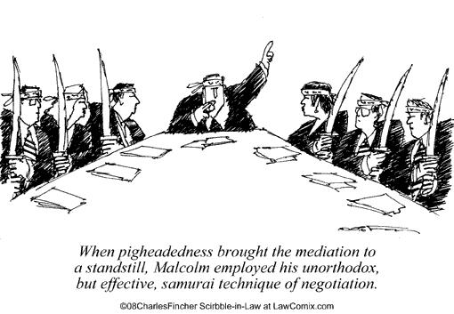
Self Determination - Mediation

Slide 43
Rule 114.13, subd. 8 Self-Determination
A mediator shall act in a manner that recognizes that mediation is based on the principle of self-determination by the parties.

Slide 45
ADR Ethics Board Process
Investigated
Finding of violation
Sanction
Investigation
Complaint is filed
Dismissed
Dismissed

Slide 46
Total Complaints by Category 2001-2021
    Total Complaints 267
    Impartiality 189
    Conflict of Interest 90
    Confidentiality 71
    Competence 98
    Quality of Process 211
    Advertising and Marketing 27
    Fees 100
    Self-Determination 40

Slide 47
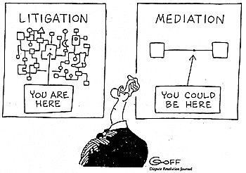

Slide 48
James J. Street
James@Tuftlaw.com

